Slide 1
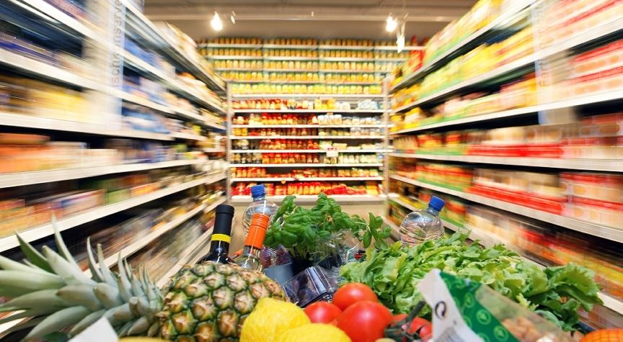
Supermarket & Grocery Industry
Eileen Min Byul Kim / Garrett Lane / Katherin Carver-Mera / Santiago Salazar

Slide 2
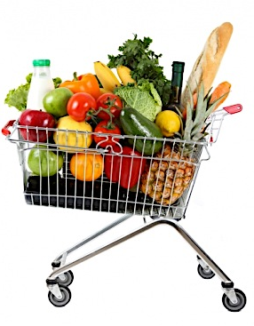
AGENDA
Introduction
Industry Analysis
Pricing Strategies
Recommendations

Slide 3
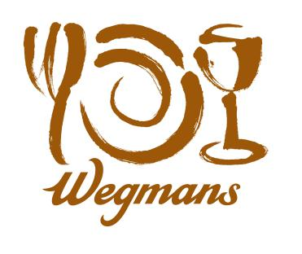
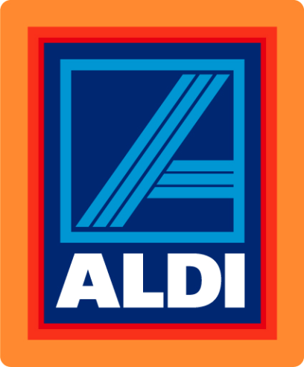



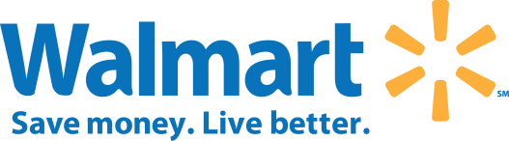
Why the Industry?
Competitive industry
Homogenous products
Pricing is crucial in the industry
Interesting to see ways of differentiation

Slide 4
Industry Analysis

Slide 5
Industry Definition
The supermarket and grocery stores industry makes up the largest food retail channel in the US
These establishments are primarily engaged in retailing general lines of food products
Primary Activity
Retailing a general line of food
Major Products
Notes:
So, the supermarket and grocery stores industry makes up the largest food retail channel in the US. And these establishments are primarily engaged in retailing general lines of food products such as fresh and prepared meats, poultry and seafood, frozen foods, fresh fruits and vegetables and various dairy products.

Slide 6

Customer
Typical grocery store customer: female head of a household
Household with children spend considerable more on groceries than childless households
Notes:
Then who are the buyers of these products? According to IbisWorld, in terms of gender, typical grocery store customer tends to be the female head of a household.
Moreover, household with children tends to spend more than childless households.

Slide 7
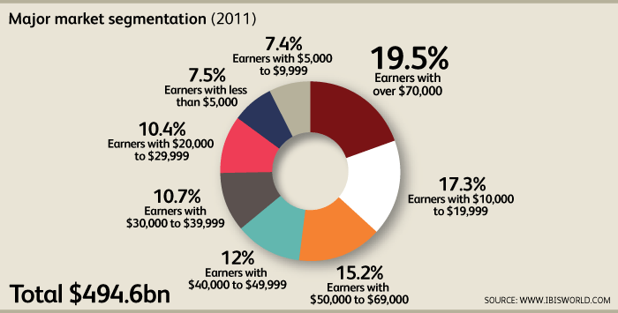
Customer
Notes:
in terms of income,
Americans earning over $40,000 are estimated to represent for almost half of supermarket sales. Those who earn over $70,000 a year are expected to account for nearly 20% of supermarket food consumption; and those who earn the income of less than $5,000 account for only 7.5% of total supermarket sales.

Slide 8
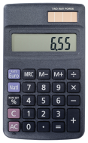
Cost
Notes:
Then, how are the costs of supermarket and grocery like?
Typical of retail industries, the cost of goods sold is the Supermarket and Grocery Stores industry’s largest expense category, with purchases accounting for 72% of industry revenue. This cost category consists of goods purchased from vendors (e.g. wholesalers and processors) for resale to consumers. It is essential for these companies to have sufficient stock at hand to meet consumer demand, thus all purchases.
The second largest cost in the industry is employee compensation, which stands slightly below 10% of a company’s sales.
Other expenses include advertising, research and development, and various administrative costs.

Slide 9
Distribution
Effective supply chain management crucial
Keeps costs low
Large companies
Manufacturers
Small chains & independent retailers
Wholesalers
Number of distributors
Food brokers
Volume discounts
Trade funds
Distribution centers?
Direct shipments?
Notes:
How are the products distributed to the supermarket stores?
Because grocery retailing is generally a high volume/low margin business, effective supply chain management is key to keeping costs low. And while large companies buy directly from manufacturers, small chains and independent retailers rely on wholesalers. But depending on product mix, companies may buy from many distributors, use food brokers, get volume discounts or trade funds, which allow grocery stores to discount or promote certain products without sacrificing margins.
(Food brokers are independent sales agents who own their own businesses. They negotiate sales for producers and manufacturers of food and food products.)
Most chains have distribution centers that receive and redistribute merchandise among individual stores. Companies may own or lease truck fleets to transport goods. But to reduce transportation and distribution costs, large chains may arrange for direct shipment from manufacturers to stores for certain large orders.

Slide 10
Competition
HHI = 384.89
C₄= 35.8
About 65,000 supermarkets with combined annual revenue of $470B
Competition high
Trend is increasing
Concentration low
Very fragmented
Notes:
Now, let’s look at the competition in the industry.
We looked at the competition in terms of nationwide and the top three players in the industry are Kroger, Safeway, and Supervalu.
The market share for Kroger was 16.6%, Safeway 8.7%, Supervalu 5.8% and other companies accounted for 68.9%. With this data, the HHI was calculated to be only 384.89 and the four-firm ration was 35.8. Thus, we can see that this industry is very competitive and is very scattered. In fact, there exists about 65,000 supermarkets that raises annual revenue of $470 billion.

Slide 11
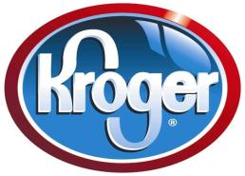
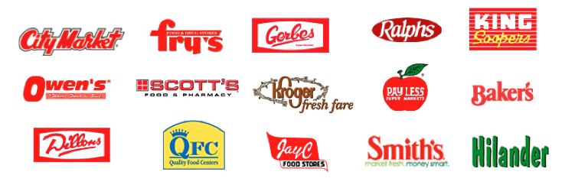
The Kroger Co.
Est. 1883
$70B company
Operates over 2,400 grocery stores
68% supermarkets
16 banner names
32 states
696 convenience stores, jewelry stores, along with manufacturing facilities
Uses private labels to differentiate products and to compete
How?
40 food-processing plants
14,000 private label items on the shelves
Sold in three tiers
Private Selection
Banner Brand
Kroger Value
Notes:
To look at the top three companies in detail…
Kroger was first established in 1883, and has evolved into a $70 billion company. It operates over 2,400 grocery stores, of which approximately 68% are supermarkets, trading under 16 banner names across 32 states. \
The company has used private labels as a way to differentiate its products and compete in this crowded market. It supports its private labels by also operating 40 food-processing plants. There are around 14,000 private label items on the company's supermarket shelves, sold in three tiers: Private Selection is the premium quality private label offering food and beverages that cater to specific gourmet tastes; the Banner brand focuses on satisfying customers and make up the majority of private label sales; and Kroger Value emphasize price.

Slide 12

Safeway Inc.
Est. 1914
$40B company
Operates over 1,700 grocery stores
West, midwest, mid-Atlantic regions in US
Self-titled supermarkets + independent grocery stores
32 manufacturing plants
US and Canada
Bread, soft drinks, and pet foods
New store lifestyle format
Newer, bigger outlets
Wider variety of perishable food, organic products and high-end groceries
Designed to compete with groceries and high-end specialist stores
Notes:
Established in 1914, Safeway operates more than 1,700 stores across the West, Midwest and mid-Atlantic regions of the United State. And generates more than $40 billion annually in grocery sales. In addition to its self-titled supermarkets, the company operates a number of independent grocery stores. Safeway operates approximately 32 manufacturing plants across the US and Canada.
Since 2003, Safeway has been converting its supermarkets into its new store lifestyle format. The newer, bigger outlets feature a wider variety of perishable food, organic products and high-end groceries, designed to compete with groceries and high-end specialist stores.

Slide 13
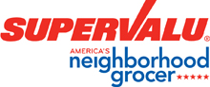
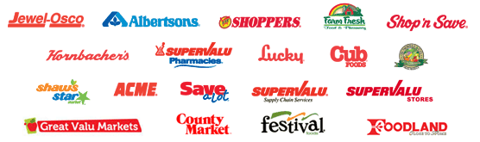
Supervalu Inc.
Est. 1870
Operates over 2,400 grocery stores
875 licensed locations
Retail food + food distribution
Retail food segment
Extreme Value stores
Regional Price Superstores
Regional Supermarkets
35 distribution centers
Largest publicly held distributor to grocery retailers in the US
Emphasis on distribution and third party logistics
Early 2009, closed abt. 50 locations
Effort to scale back spending
Notes:
Supervalu commenced operations in 1926 as a grocery distributor to the Midwest. Today, the company operates over 2,400 stores. Company operations are segmented into two categories: retail food and food distribution. The retail food segment operates three retail formats: Extreme Value stores, Regional Price Superstores and Regional Supermarkets.
In early 2009, Supervalu closed nearly 50 locations, as part of an effort to scale back spending.

Slide 14
Other Companies
Walmart Stores Inc. (N/A)
Largest external competitor of the industry
Walmart supercenters
2,746 supercenters
Open 24 hours
Wide assortment of general merchandise and groceries
Low prices
Walmart’s recent focus on groceries
54% of revenue
$135B in grocery sales
Notes:
Other than the top three just mentioned, other prominent ones include –
Other than these, however, Walmart should also be taken into account although it is categorized in a different category. Walmart is the largest external competitor due to its supercenters that possess wide assortment of general merchandise and groceries with low prices and in wide locations. Moreover, Walmart is recently focusing more on groceries as 54% of its revenue were from groceries and earned up to $135 billion.

Slide 15
Competition
Price, location, and convenience
Key factors of competition
Saturation due to homogeneous nature
Low barrier, large number of players
Consumers conscious on price
Reliance on large volume of sales with small per-item markups
Differentiation
By range and quality of products offered
Store layout and location
Threat from large retailers
Notes:
As a whole, Price, location and convenience are the key factors on which industry players compete. The level of internal rivalry is fierce, especially because the product market is so crowded. The market is saturated due to its homogeneous nature, which creates an environment in which any player can enter the industry.
Moreover, as operators fiercely compete for prices, consumers are more price conscious than ever before. As a result, supermarkets rely on a large volume of sales with small per-item markups.
With little price differentiation between operators, grocery stores must find other ways to attract customers, for example, with the range and quality of products offered. Store layout and location of individual stores also affects where consumers shop, as supermarkets located in populated areas, such as shopping malls, are likely to attract more traffic.
And again, The Supermarkets and Grocery Stores industry faces a high amount of external competition, particularly from large retailers like massive warehouse stores and supercenters.

Slide 16
Barriers to Entry
High
Low
Competition
Capital Intensity
Life Cycle Stage (Mature)
Technology Change
Concentration
Regulation and Policy
Barriers to entry in this industry are medium and is increasing
Notes:
Amidst this high competition in the industry, the barriers to entry in this industry are not high—abt the medium range—but is increasing.
The competition is high
Capital Intensity is medium
Life Cycle Stage is mature
Technology change is medium
Concentration is low
And regulation and policy of the industry is low

Slide 17
Key Success Factors
Proximity to key markets
Access to multiskilled and flexible workforce
Ability to control stock on hand
Close monitoring of competition
Access to the latest available and most efficient technology
Notes:
Then, in order to succeed in this competitive market, what are some key success factors?
1. Proximity to key markets: This factor enables operators to maximize their exposure by being located in populated areas like shopping malls. Clear signage, access and ample parking also attract shoppers.
2 Access to multiskilled and flexible workforce: Similar to other retail industries, supermarkets have a highly casual workforce, which allows stores to rotate staff as required, particularly during extended trading hours. 3 Ability to control stock on hand: Controlling stock on hand ensures that groceries are always available for purchase. 4 Close monitoring of competition: Given the mature stage of the industry and the little product differentiation, supermarkets compete on price. Earnings are generated on a large volume of goods that carry a small markup.
5 Access to the latest available and most efficient technology and techniques: as An important consideration for stores to operate productively and efficiently is having the latest in security as well as point of sale processing.

Slide 18
Pricing Strategies
Primary Pricing / Secondary Pricing

Slide 19
Primary Pricing
Everyday Low Pricing (EDLP)
High-Low Pricing (Hi-Lo or Promotion)
Hybrid Pricing (EDLP + Hi-Lo)

Slide 20
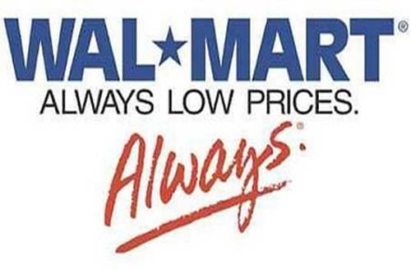
Everyday Low Pricing (EDLP)
Supermarkets have low prices all the time
Do not offer many deep-discounts
Attracts Price Sensitive Customers
In the USA, most popular in the South than Northeast
Wal-Mart is the leader on EDLP strategy

Slide 21
Examples of EDLP Strategy Used
Firm | Stores | % Promo | %HYBRID | % EDLP
Kroger | 1,399 | 47 | 40 | 13
Safeway | 1,165 | 52 | 43 | 5
Albertson’s | 922 | 11 | 41 | 48
Winn-Dixie | 1,174 | 3 | 30 | 67
Lucky | 813 | 35 | 38 | 27
Giant | 711 | 29 | 60 | 11
Fred Meyer | 821 | 22 | 60 | 18
Wal-Mart | 487 | 1 | 26 | 73
Publix | 581 | 13 | 71 | 16
Food Lion | 1,186 | 2 | 12 | 86
A&P | 698 | 55 | 30 | 15
H.E. B. | 250 | 1 | 3 | 96
Stop & Shop | 189 | 50 | 43 | 7
Cub foods | 375 | 26 | 34 | 40
Pathmark | 135 | 42 | 25 | 33

Slide 22
Advantages of EDLP
Consistency
General discount not as steep as Hi-Lo stores
Low operating costs

Slide 23
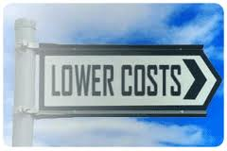


Profitability of EDLP
Profitability depends on
Walmart’s plan
Increase competitive checks
Partner closely with suppliers
Price matching policy
Broaden product assortment (8,500 items)
Demand

Slide 24
Reduced Price Items: EDLP
Chain | Areas Served | No. Reduced Price Items | Sample Items
WEGMANS | Rochester, NY; Princeton NJ; Fairfax, Va. | 10,000 | Peter Pan peanut butter in 18oz. Jars used to sell for 2.29; went on special 4 times/year for $0.99. Now it sells for 1.79 daily. No longer goes on special
GIANT EAGLE | Pittsburg and Cleveland | 4,300 | General Mills Cheerios in a 15 oz. box, used to sell for $4.39. Now for $3.11
RALEY’S | Sacramento, Cal Reno, Nev. Albuquerque, N.M. | 7,000 | 1 lb. packs of stick butter used to sell for $4.49, went on special 8 times/year: 2 for $5. Now, $2.99

Slide 25
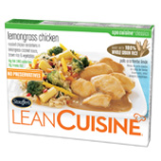
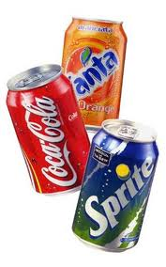
High-Low Pricing
High-Low Pricing (Hi-Lo or Promotion)
Everyday-high-prices with frequent promotions
Attracts Price Sensitive Customers
Key low-priced items on local newspaper adv., store coupons, or flyers (soft drinks, frozen entrees)
Other items priced at regular price

Slide 26
Example of Hi-Lo Strategy Used
Firm | Stores | % Promo (hi-Lo) | %HYBRID | % EDLP
Kroger | 1,399 | 47 | 40 | 13
Safeway | 1,165 | 52 | 43 | 5
Albertson’s | 922 | 11 | 41 | 48
Winn-Dixie | 1,174 | 3 | 30 | 67
Lucky | 813 | 35 | 38 | 27
Giant | 711 | 29 | 60 | 11
Fred Meyer | 821 | 22 | 60 | 18
Wal-Mart | 487 | 1 | 26 | 73
Publix | 581 | 13 | 71 | 16
Food Lion | 1,186 | 2 | 12 | 86
A&P | 698 | 55 | 30 | 15
H.E. B. | 250 | 1 | 3 | 96
Stop & Shop | 189 | 50 | 43 | 7
Cub foods | 375 | 26 | 34 | 40
Pathmark | 135 | 42 | 25 | 33

Slide 27
Reasons to Use Hi-Lo Pricing
Promote store traffic
Low prices in attractive products will bring customers to the store
Persuade low prices with few discounts
Number of discounts offered rather than cumulative savings
Overall Store Profitability
Loss leaders’ products shelved in inconvenient locations

Slide 28
Profitability of Hi-Lo
Increased Revenue
Revenue Lost
But how?

Slide 29
How Revenue is Made: Hi-Lo
Consumer pays for sale item
While purchasing other item at regular price
Revenues increase

Slide 30
Hybrid Pricing
Number of categories put on sale varies
Frequency of sale varies
EDLP
Hi-Lo
Hybrid

Slide 31
Example of Hybrid Pricing Used
Firm | Stores | % Promo (hi-Lo) | %HYBRID | % EDLP
Kroger | 1,399 | 47 | 40 | 13
Safeway | 1,165 | 52 | 43 | 5
Albertson’s | 922 | 11 | 41 | 48
Winn-Dixie | 1,174 | 3 | 30 | 67
Lucky | 813 | 35 | 38 | 27
Giant | 711 | 29 | 60 | 11
Fred Meyer | 821 | 22 | 60 | 18
Wal-Mart | 487 | 1 | 26 | 73
Publix | 581 | 13 | 71 | 16
Food Lion | 1,186 | 2 | 12 | 86
A&P | 698 | 55 | 30 | 15
H.E. B. | 250 | 1 | 3 | 96
Stop & Shop | 189 | 50 | 43 | 7
Cub foods | 375 | 26 | 34 | 40
Pathmark | 135 | 42 | 25 | 33

Slide 32
Demographics and Pricing Strategies
EDLP
Larger Households
More Racial Diversity
Fewer Vehicles
Lower Income
Hi-Lo
Hybrid
fewer Households
Less Racial Diversity
More Vehicles
Higher Income

Slide 33
Secondary Pricing Strategies
Psychological
Private Brands
Slotting
Coupons
Loyalty Programs

Slide 34
Psychological Pricing
Method of manipulating and confusing shoppers (classic $2.99 vs. $3.00)
“Rational inattention Theory” (Bergen et al., 2003)
Nominal Pricing more important
Price rigidity
Quantity discounts (3 for $9.99)

Slide 35
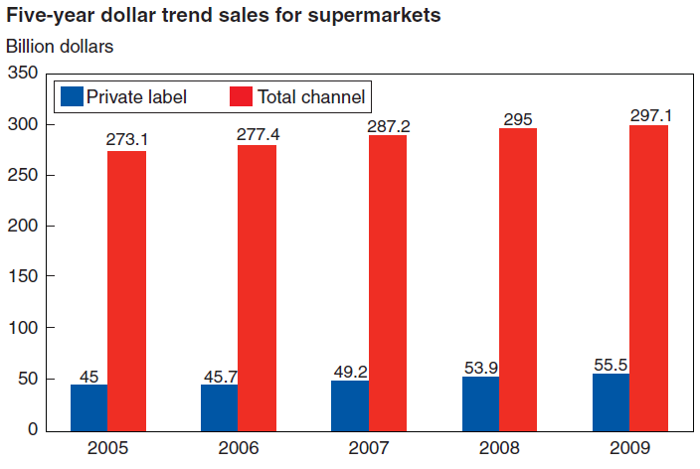
Private Labels: Revenue Trends
Source:http://www.ers.usda.gov/Publications/ERR129/ERR129.pdf
Source of revenue growth
8.7% Total Revenue Growth
23.3% PL
2% Increase in PL as a proportion of Total Revenue
Notes:
Higher Retail Margins
Much of the recent PL increase in market share and sales can be explained
by the 2007-08 food price spike and 2007-09 recession. Lamey et al.
(2007) showed that PL demand increases and NB demand decreases during
economic downturns, owing mostly to lower PL prices for comparable products.
Confirming this pattern for the recent recession, Straczynski (2009)
found that PL dollar sales increased by 7.4 percent from July 2008 through
July 2009. This increase significantly outpaced the average PL growth of the
previous 5 years. (http://www.ers.usda.gov/Publications/ERR129/ERR129.pdf)

Slide 36
Price Differential
Source: http://www.ers.usda.gov/Publications/ERR129/ERR129.pdf
Notes:
On average priced 23% lower than NB

Slide 37
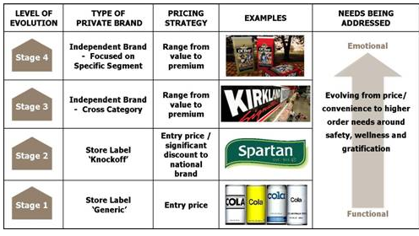
Private Labels: Evolution
Source: http://www.greenbook.org/marketing-research.cfm/evolution-of-private-brands
Notes:
2-Tier Store Brand Strategy
Safeway’s “Select” vs. Wal-Mart’s “Sam’s American Choice”
WHY? Risk-aversion

Slide 38
In Ithaca

Slide 39
Slotting
Slotting arrangements are fees manufacturers pay grocery chains for shelf space.
Since 1980s fees have grown in size and number of products
Low cost retailers have higher slotting allowances
For manufacturers, lower fees are paid with high market share position
Justification:
Asymmetric Information
Solution to the problem of adverse selection
Product innovation, reduced risk
Solving Moral Hazard

Slide 40
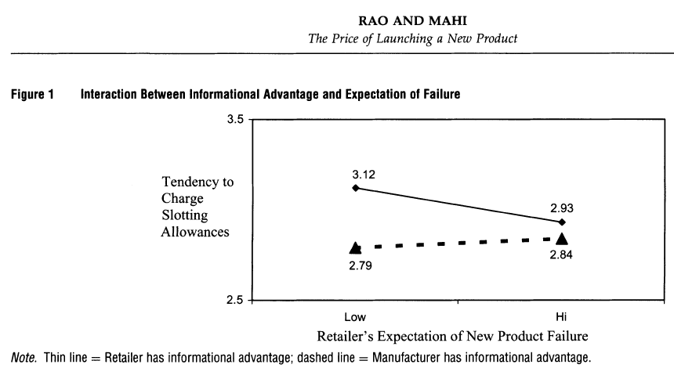
Shift in Asymmetry?

Slide 41
Slotting
Mostly cash rather than kind
Fees ranged from $2 to $10 per case (Rao and Mahi)
Annual Expenditures on slotting range from 6 to 9 billion
16% of Introduction costs
About half of product promotion expenditures

Slide 42
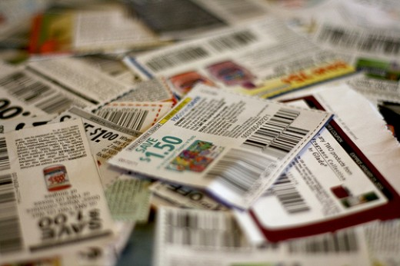
Coupons
Notes:
Another secondary pricing strategy that is implemented in grocery stores is coupons. Coupons are mostly producer distributed rebates that save on specific items depending on the number purchased. Stores will also put out their own coupons at times

Slide 43
Coupons
29% of companies focus more on using coupons
Top Grocery Items Couponed
Candy and Gum, Refrigerated Meats , Breakfast Foods
Why do companies use coupons for grocery products?
57 % encourage product trial
29% boost retailer support of their product
14% increase brand awareness
Value of Coupons
$470 billion of coupon value distributed (2011)
$4.6 billion redeemed
Average face value of a grocery coupon is $1.17 each
Notes:
Last year 29 percent of companies decided to focus on using coupons more for promotion. The biggest reason for coupons is to encourage product trial, as you can that more than half of the time, it is the reason. In fact it can sometimes be rare that you find coupons for a product that already has a strong loyalty to it. Among the other reasons for couponing are attempts to have retailers put more of a product in stores and to increase brand awareness. The total value of coupons put out each year is astonishing, last year more than 470 billion dollars of coupons were distributed. And only 4.6 billion was redeemed by customers. As you can see it takes a lot of coupons to be put out there for the coupons to be actually used by consumers. Many shoppers don’t see the value in just one coupon, however if they use a few at a time, the worth seems much greater. Finally on average a grocery coupon has a value of $1.17.

Slide 44
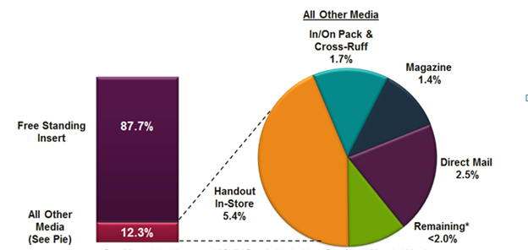
Coupon Distribution by Volume for Grocery Products
Included in the “Remaining” category are internet and mobile coupons
Notes:
Most of the time people who coupon get their coupons from a free standing insert inside their Sunday newspaper. It is still by far the most popular way of distributing coupons even with the recent trends in technology away from newspapers. In fact more than 98 percent of coupons are distributed by means of paper coupons.

Slide 45
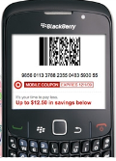
Digital Coupons
Caused by the decline of newspaper readers coupled with the emergence of smartphones and internet access
Represent between 0.5% and 5% of coupons distributed
Highest Redemption Rate for any type of distribution – Average of 18%
Lots of room for expansion
Notes:
Digital Coupons are on the rise however. With the emergence of smartphones and tablets, many stores are seeing the value in sending out mobile and email coupons. They are by far the highest redeemed rate of coupon distribution at 18%. The redemption rate of FSI coupons is less than 1 percent. There is a lot of room for expansion here because since they are so highly redeemed, if they distribute more, there is a likely chance they will by effective.

Slide 46
Loyalty Programs
More effective for the high volume, frequent shoppers
Many people who sign up for the loyalty program have shopped there before (88%)
Provide useful data for store managers
Doubt as to whether or not they create brand loyalty
Since there is no sign-up fee people sometimes become members at more than one store
Many people base loyalty to a certain store based on other characteristics
Distance
Customer Service
Selection
Notes:
Loyalty Programs are put out by stores in order to increase the incentive for shoppers to spend more time at their store. Grocery stores provide all sorts of pricing and customer service incentives for the subscribers. They do provide savings, but perhaps not as much as many may originally perceive. They are mostly effective for the high volume shoppers because they are the ones that will take advantage of the most deals throughout the store. Often times the most sought after goods won’t be what is on sale for members. Most people who sign up for memberships have shopped there for a while before signing up and finally realizing the savings. Loyalty programs also help the store by being able to track all sorts of data and purchase habits of certain types of consumers.

Slide 47
Loyalty Member Clusters
Ideal, highly loyal shoppers– 1.05%
Half loyal shoppers – 9%
Late but enthusiastic followers – 2%
Shoppers who lost their enthusiasm – 36%
Very infrequent card shoppers – 13%
Shoppers who wanted to like it but did not – 38%
Notes:
One study showed that members of loyalty programs fall into one of six different categories. The first three are types that use it the most often, they also tend to be the smallest of the groups. The first group is the ones who shop 100 percent of the time at that store and they shop there often, taking up just over 1% of members. Second are people who frequent the stores but also tend to shop other stores as well. Then there are people that catch onto the membership program later than most because they either live far away or they just did not know about it. Among those that don’t use the card benefits as much are shoppers who used the card a lot at first and then fizzled off, people who just don’t shop enough at the store and people that wanted to like the benefits at first but once using it they did not. These 3 groups make up 87% of card members.

Slide 48
Loyalty Programs: Wegmans vs. Top’s
Shoppers Club
Bonus Plus
Additional Savings on different products weekly
Subscription to Menu Magazine
Online Account
Access to W-Dollars Program
Product Recall Notification
Savings Discounts
Pre-Priced Discounts
Double Coupons
Buy-One Get-One Deals
Gas Station Discounts
Online Account
Notes:
Just a brief overview of the 2 member programs in the Ithaca region, the Wegmans Shopper’s Club Card and the Tops BonusPlus Program. They are actually somewhat different. Wegmans program is customer based with savings as an additional incentive and Tops is mostly a savings oriented program.

Slide 49
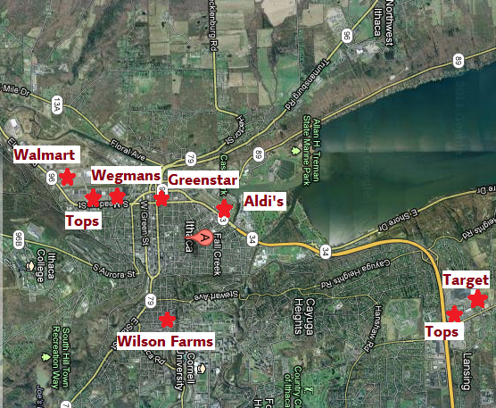
Ithaca Grocery Market
Aldi’s, Greenstar, Target, Tops, Walmart, Wegmans, Wilson Farms

Slide 50
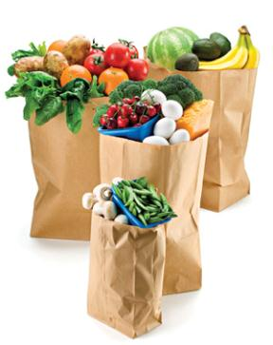
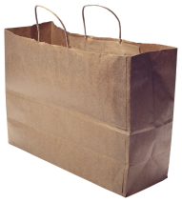
Our Basket
Bananas
2% Milk
Potatoes
Baby Carrots
Apples
Orange Juice
Eggs
White Bread
Chicken Noodle Soup
Ground Beef
Sliced American Cheese
Cheerios
We used as many name brand products as possible, but not every store carried those products.

Slide 51
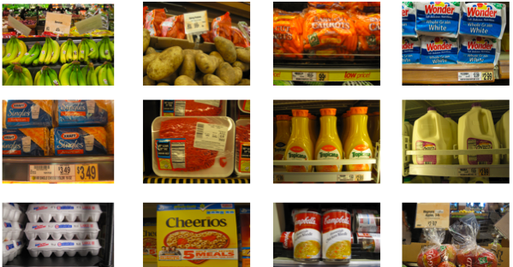
Our trip to the local grocery stores

Slide 52
Pricing Comparisons of
the Ithaca Grocery Market
Notes:
This is the graph for all the product we looked at arranged from lowest priced goods to the higher priced ones. We made sure all prices were based on unit weight or volume. As you can see there is high variety among the higher priced goods and the lower priced goods tend to be similarly priced, so we graphed just the lower priced goods to show more obviously the price trends there.

Slide 53
Comparisons of the
8 lowest priced goods
Notes:
Here you can see some trends forming as far as how goods are priced at each store. Also you can see groups forming, GreenStar and Wilson Farms pricing themselves exceptionally high overall, then Wegmans and Tops sell at more reasonable levels, below that are Walmart and Target and then there is Aldi in a price level of its own. We will go on to discuss each of these groups.

Slide 54
Classic Grocery Stores: Wegmans and Tops
Classic Grocery Stores: stores whose main focus is selling grocery products, often use hybrid pricing strategies
Wegmans prices are roughly the median of all the stores in the Ithaca area
Competitive Advantage – Customer Service and Market Department
Most popular of the stores
Tops prices higher than Wegmans
Promotes highly its BonusPlus loyalty program for the best deals
Has its own gas station to encourage shoppers to make one-stop shopping trips

Slide 55
Supercenters: Walmart and Target
Supercenters: Stores that sell a wide variety of products, have a grocery department but it is not the main focus, use hybrid pricing
Walmart has prices lower than either of the Classic Grocery Stores
Many perceive the product quality and customer service as below average
Target only recently opened a grocery department in the Ithaca area
Very competitive pricing, comparable to Walmart less than Tops and Wegmans
Convenient location could lead to large growth

Slide 56
Specialty Grocery Stores: GreenStar and Wilson Farms
Specialty Grocery Stores: Stores that focus on grocery products but have a specific target market, can price higher due to specialization
GreenStar sells organic and natural foods
Can price higher because it serves a special niche market segment
Higher cost of inventory because of the organic nature of the products
Wilson Farms is in a prime location for most Cornell students
Being the only major grocery store in Collegetown gives them a competitive advantage
Lack of competition leads to higher prices

Slide 57
Value Grocery: Aldi’s
Value Grocery Store: store that focuses on grocery products but sells products it can sell at an extreme discount, every day low pricing
Sells off brand items at extremely low prices
Sometimes leads to skeptical shopping behavior of customers, especially with produce and meat
The store is not organized to display products in a comparable manner to other stores

Slide 58
Recommendations

Slide 59
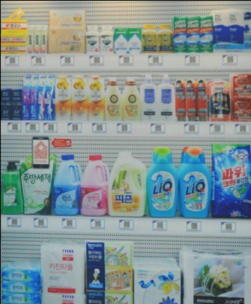
Opportunity
Potential for Internet/Smartphone market
Convenience
Low cost
http://www.youtube.com/watch?v=dx7aRhKej0w&feature=related
Notes:
While most companies have Internet sites that communicate basic store operating information, Internet sales are still a tiny part of the grocery market.
A growing number of supermarkets are experimenting with apps and high-tech bar codes known as quick response codes to win more business from smartphone-carrying shoppers.
Investing in smartphone technology allows supermarkets to reach out to shoppers in a new way without investing a large amount of money.

Slide 60
Opportunity
Mobile Coupons
High redemption rate
Easy for people to access
Private Label Expansion
Vertical Integration – Reduce Costs
Creates Brand Differentiation
Better Serving Customer needs
Recommendation for Ithaca Market
Bring a EDLP/Hybrid store closer to Cornell Campus

Slide 61
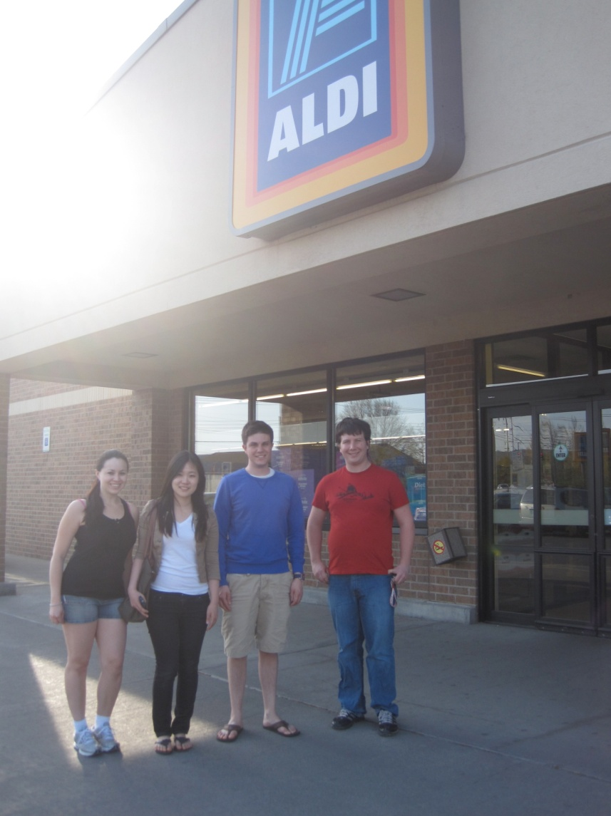
Thank You!
Questions
& Answers

